Slide 1
Simultaneous Localization & Mapping - SLAM
Praveen K Santhanam – pks6

Slide 2
NUT SHELL
SLAM is a technique used to build up a map within an unknown environment or a known environment while at the same time keeping track of the current location.

Slide 3

To a human
Assume you are blindfolded in a room

Slide 4
What is SLAM?
The problem has 2 stages
  Mapping
  Localization
The paradox:
  In order to build a map, we must know our position
  To determine our position, we need a map!
SLAM is like the chicken-egg problem
Solution is to alternate between the two steps.

Slide 5
SLAM – Multiple parts
Landmark extraction
data association
State estimation
state update
landmark update
There are many ways to solve each of
the smaller parts

Slide 6
Hardware
Mobile Robot
Range Measurement Device
  Laser scanner – CANNOT be used underwater
  Sonar – NOT accurate
  Vision – Cannot be used in a room with NO light

Slide 7
The goal of the process
The SLAM process consists of number of steps.
Use environment to update the position of the robot. Since the odometry of the robot is often erroneous we cannot rely directly on the odometry.
We can use laser scans of the environment to correct the position of the robot.
This is accomplished by extracting features from the environment and re observing when the robot moves around.

Slide 8
Extended Kalman Filter
An EKF (Extended Kalman Filter) is the heart of the SLAM process.
It is responsible for updating where the robot thinks it is based on the Landmarks (features).
The EKF keeps track of an estimate of the uncertainty in the robots position and also the uncertainty in these landmarks it has seen in the environment.

Slide 9
Overview
Laser Scans
Odometry Change
Landmark Extraction
EKF Odometry update
Data Association
EKF Re-observation
EKF New
Observations

Slide 15
Laser & Odometry data
Laser data is the reading obtained from the scan
The goal of the odometry data is to provide an approximate position of the robot
The difficult part about the odometry data and the laser data is to get the timing right.

Slide 16
Landmarks
Landmarks are features which can easily be re-observed and distinguished from the environment.
These are used by the robot to find out where it is (to localize itself).

Slide 17
The key points about suitable Landmarks
Landmarks should be easily re-observable.
Individual landmarks should be distinguishable from each other.
Landmarks should be plentiful in the environment.
Landmarks should be stationary.

Slide 18
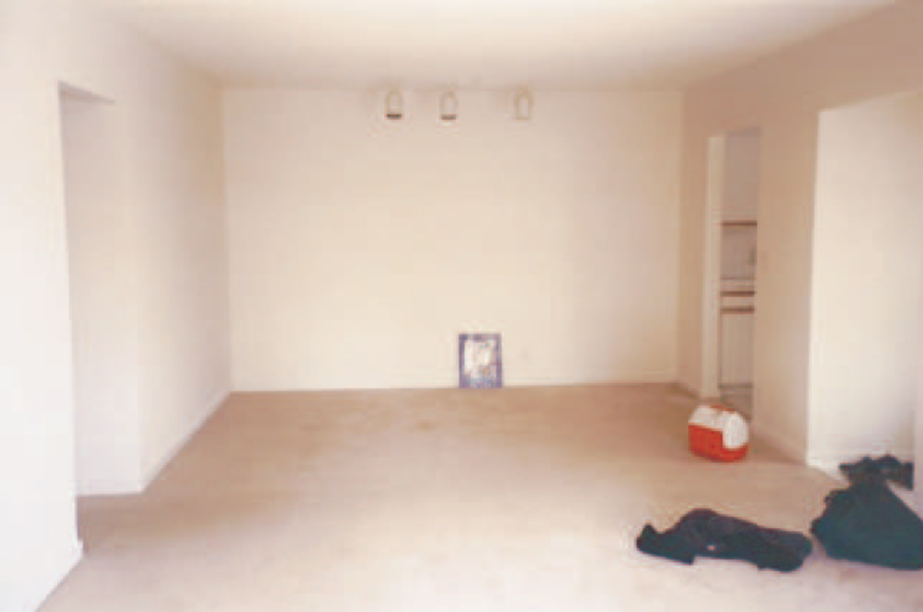
In an indoor environment such as that used by our robot there are many straight lines and well defined corners. These could all be used as landmarks.

Slide 19
Landmark Extraction
Once we have decided on what landmarks a robot should utilize we need to be able to somehow reliably extract them from the robots sensory inputs.
The 2 basic Landmark Extraction Algorithms used are Spikes and RANSAC

Slide 20
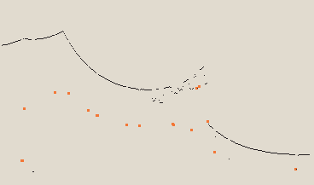
Spike
The spike landmark extraction uses extrema to find landmarks.
when some of the laser scanner beams reflect from a wall and
some of the laser scanner beams do not hit this wall, but are
reflected from some things further behind the wall.
Spike landmarks. The red dots are table legs extracted as landmarks.
Spike landmarks rely on the landscape changing a lot between two laser beams. This means that the algorithm will fail in smooth environments.

Slide 21
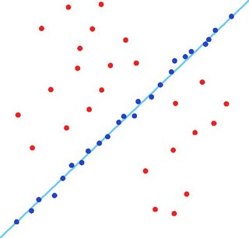
RANSAC (Random Sampling Consensus)
This method can be used to extract lines from a laser scan that can in turn be used as landmarks.
RANSAC finds these line landmarks by randomly taking a sample of the laser readings and then using a least squares approximation to find the best fit line that runs through these readings.
Consensus

Slide 22
Data Association
The problem of data association is that of matching observed landmarks from different (laser) scans with each other.
Problems in Data Association
  You might not re-observe landmarks every time.
  You might observe something as being a landmark but fail to ever see it again.
  You might wrongly associate a landmark to a previously seen landmark.

Slide 23
Algorithm – Nearest Neighbour Approach
When you get a new laser scan use landmark extraction to extract all visible landmarks.
Associate each extracted landmark to the closest landmark we have seen more than N times in the database.
Pass each of these pairs of associations (extracted landmark, landmark in database) through a validation gate.
  If the pair passes the validation gate it must be the same landmark we have re-observed so increment the number of times we have seen it in the database.
  If the pair fails the validation gate add this landmark as a new landmark in the database and set the number of times we have seen it to 1.

Slide 24
Overview of the process
Update the current state estimate using the odometry data
Update the estimated state from re-observing landmarks.
Add new landmarks to the current state.

Slide 25
Final Review – Open Areas
There is the problem of closing the loop. This problem is concerned with the robot returning to a place it has seen before. The robot should recognize this and use the new found information to update the position.
Furthermore the robot should update the landmarks found before the robot returned to a known place, propagating the correction back along the path.

Slide 26
References
Slam for dummies, by Soren Riisgaard & Morten Rufus Blas
Wikipedia - Slam
Minimal Slam for Efficient Floor-Planning, by Stephen Pfetsch
http://farm1.static.flickr.com/34/101152162_a59da9b562.jpg
http://3.bp.blogspot.com/_beboLKBKnDc/Ryai4RoJavI/AAAAAAAAACI/oq5h56z9ZzY/s320/Fitted_line.jpg

